Slide 1
Software Engineering and Architecture
Git in Practice

Slide 2
Git
A highly personalized view, so take it as my opinion
Git is driving a Ferrari without a safety belt!
  There are one zillion handles to crank!
  There are zillions of way to use Git efficiently
  There are zillions of way to get lost or mess your repo up completely
  Keep it simple! You ain’t gonna need it!
And
  Beware of the good spirit fellow student that ‘helps you’ by issuing a few weird git command you do not understand!
    And makes git behave weird for the rest of the course

Slide 3
And…
Some have issues with authenticating with AU Git Lab
Sigh…

Slide 4
If Git F… up badly?
I have more than once done the ‘reboot’
Delete the local workspace
  Remove from IntelliJ, delete folder with project
Clone the repo anew
  Much better than let a fellow Git-Wizzard issue ten weird commands, give up and walk away, leaving you with:
    Big ball of mud

Slide 5
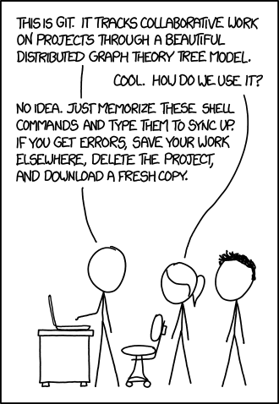
I am not alone ☺

Slide 6
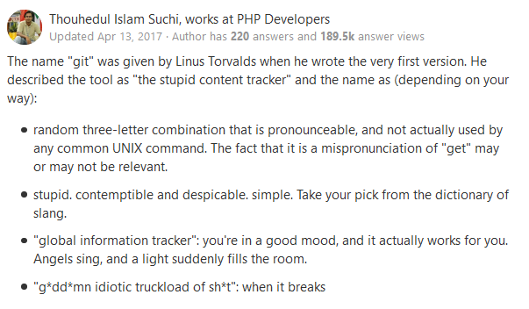
(The Name?)
According to Quora

Slide 7
The Core Workflow
Git clone (your repo name)
  Get your copy of the code base (Done once! Or if ‘rebooting’ ☺)
Git add (file)
  Add newly made files to the staging area/index (See below)
Git commit –a –m ”meaningful explanation of what you made”
  ”-a” auto adds all changes to existing files in repo the staging area / index
  “-m” provide a log message
  IntelliJ will help remember to add them to the index when created within it.

Slide 8
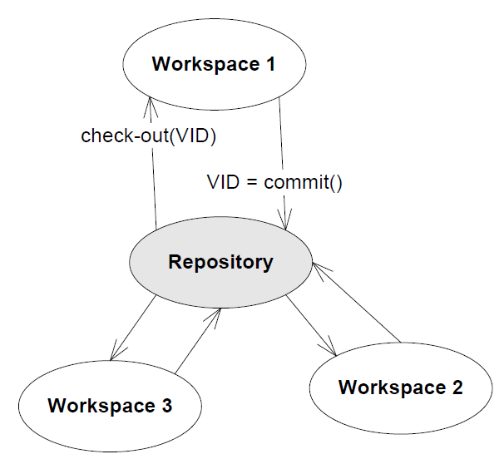
The Core Workflow
Git push
  Copy all your commits to the team’s remote repository
Git pull
  Get your team mates commits into your local repo
    Merge conflicts must be handled
Git status
  See status of your local workspace
Git log -3
  See last 3 versions’ log messages
pull
push

Slide 9
Branching
Git fetch origin
  Get the branches overview from the origin + all newly made branches
Git branch –a
  Show all branches including all on the origin that you do not have currently
Git checkout {branchname}
  Checkout given branch, switch to it, and begin tracking it
Git checkout –b {branchname}
  Create a new branch, switch to it, and begin tracking it

Slide 10
.gitignore
Do not pollute your repo!
  There are ‘source’ artefacts and there are ‘derived’ artefacts
    Source = manual hard intellectual work
      Java source files, graphics files, sound clips, etc.
    Derived = a tool produces it in milliseconds
      .class files, .jar, JavaDoc, test output, coverage HTML, …
.gitignore
  Put a file ‘.gitignore’ in your root
  State all ‘derived’ artefacts in it (folders, file wildcards)
    /build ignore all that gradle produces in the build folder
    *.iml ignore IntelliJ configuration files
    /out ignore all IntelliJ generated files

Slide 11
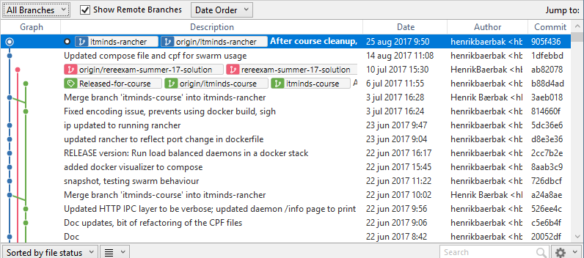
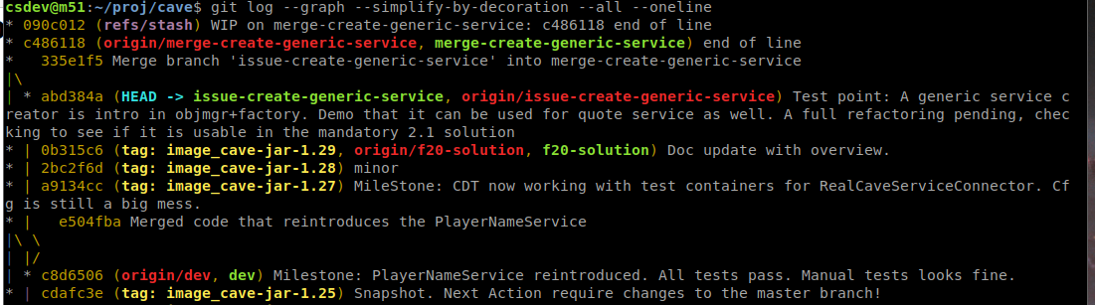
My own workflow
Overviewing branches without graphics is hard!
I develop on Lubuntu
  But makes most branching/merging in SourceTree on Windows ☺
But can be viewed in shell:

Slide 12
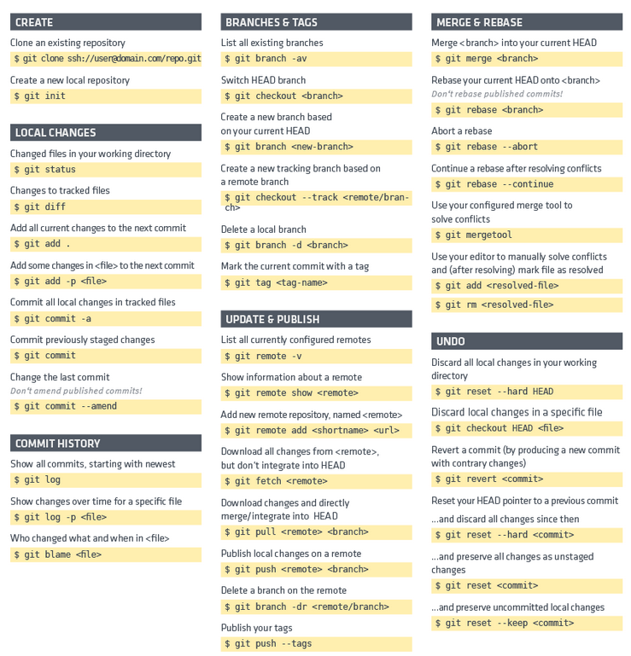
CheatSheet
Git-tower.com

Slide 13
Best Practices
Commit related changes
  Fixing two bugs should lead to two commits
Commit often
  ‘Take small steps’, break big into small, one step at a time
  Safe version to retract to in case of ‘Do Over’
Push and pull often
  Do not let team efforts drift apart!

Slide 14
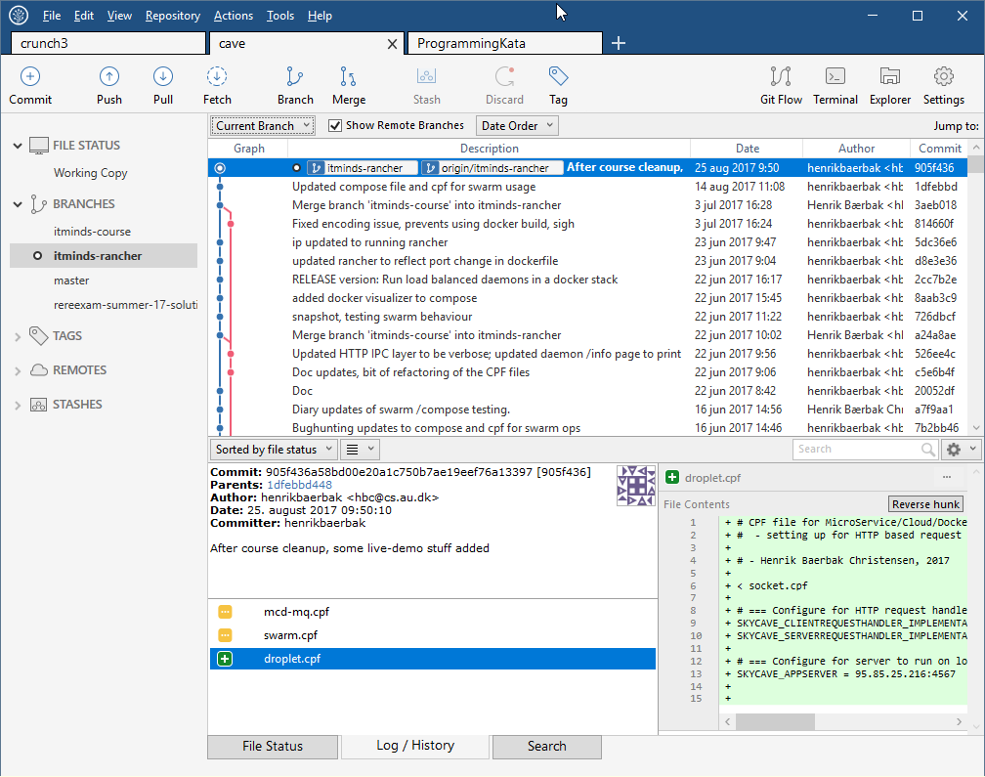
Best Practices
Use the commit log to express the goal achieved/contents of the commit

Slide 15
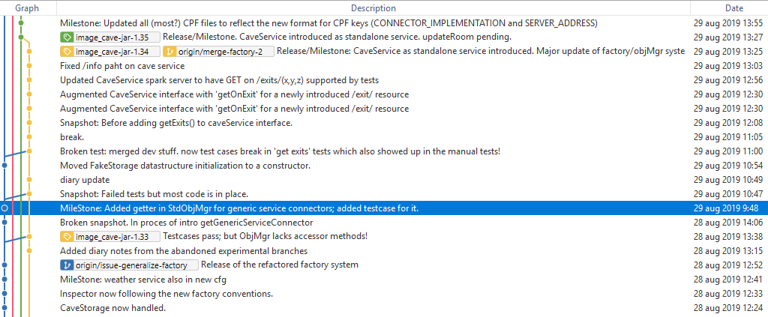
Best Practices
I have developed a practice of a ‘tag line’
Release: All features are working now
ReleaseCandidate: All features working (I think)
Milestone: Major (part) feature working now
Snapshot: Safe ground to retract to, all tests pass, typically before starting new feature TDD.
Broken: Failing test case present, show ‘I got to this point before taking a break’

Slide 16
Best Practices
Commits may break but pushed ones may not
  I sometimes commit broken builds if I must change work task
    They highlight what I am working on to myself the next day!
  But never push them
    Pushed commits must reflect a finished step/feature/bugfix/all tests pass
  But – best practice is of course that also commits have all tests passing

Slide 17
Mandatory Note
Use AU GitLab. Make it private!
Use your own login name on Git repo when you are in the ‘driver seat’ = programmer role in TDD
TAs are instructed to review you logs for
  Clarity and sensible commit logs
  ‘small steps and commit often’
  Equal workload of each group participant

